Slide 1

Chapter 13
Digital Signature
Copyright © The McGraw-Hill Companies, Inc. Permission required for reproduction or display.

Slide 2
Chapter 13
Objectives
To define a digital signature
To define security services provided by a digital signature
To define attacks on digital signatures
To discuss some digital signature schemes, including RSA, ElGamal,
Schnorr, DSS, and elliptic curve
To describe some applications of digital signatures

Slide 3
13-1 COMPARISON
Let us begin by looking at the differences between conventional signatures and digital signatures.
Topics discussed in this section:
13.1.1 Inclusion 390
13.1.2 Verification Method 390
13.1.3 Relationship 390
13.1.4 Duplicity 390

Slide 4
13.1.1 Inclusion
A conventional signature is included in the document; it is part of the document. But when we sign a document digitally, we send the signature as a separate document.

Slide 5
13.1.2 Verification Method
For a conventional signature, when the recipient receives a document, she compares the signature on the document with the signature on file. For a digital signature, the recipient receives the message and the signature. The recipient needs to apply a verification technique to the combination of the message and the signature to verify the authenticity.

Slide 6
13.1.3 Relationship
For a conventional signature, there is normally a one-to-many relationship between a signature and documents. For a digital signature, there is a one-to-one relationship between a signature and a message.

Slide 7
13.1.4 Duplicity
In conventional signature, a copy of the signed document can be distinguished from the original one on file. In digital signature, there is no such distinction unless there is a factor of time on the document.

Slide 8
13-2 PROCESS
Figure 13.1 shows the digital signature process. The sender uses a signing algorithm to sign the message. The message and the signature are sent to the receiver. The receiver receives the message and the signature and applies the verifying algorithm to the combination. If the result is true, the message is accepted; otherwise, it is rejected.
Topics discussed in this section:
13.2.1 Need for Keys
13.2.2 Signing the Digest

Slide 9
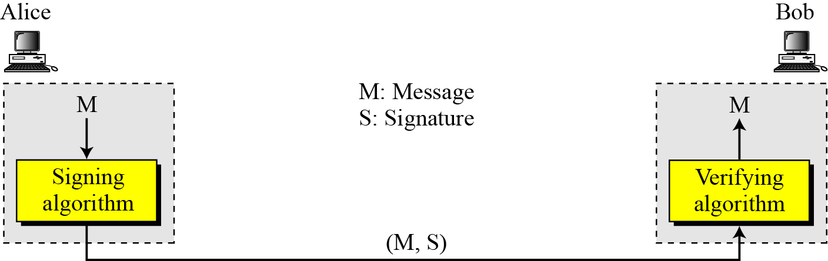
13-2 Continued
Figure 13.1 Digital signature process

Slide 10
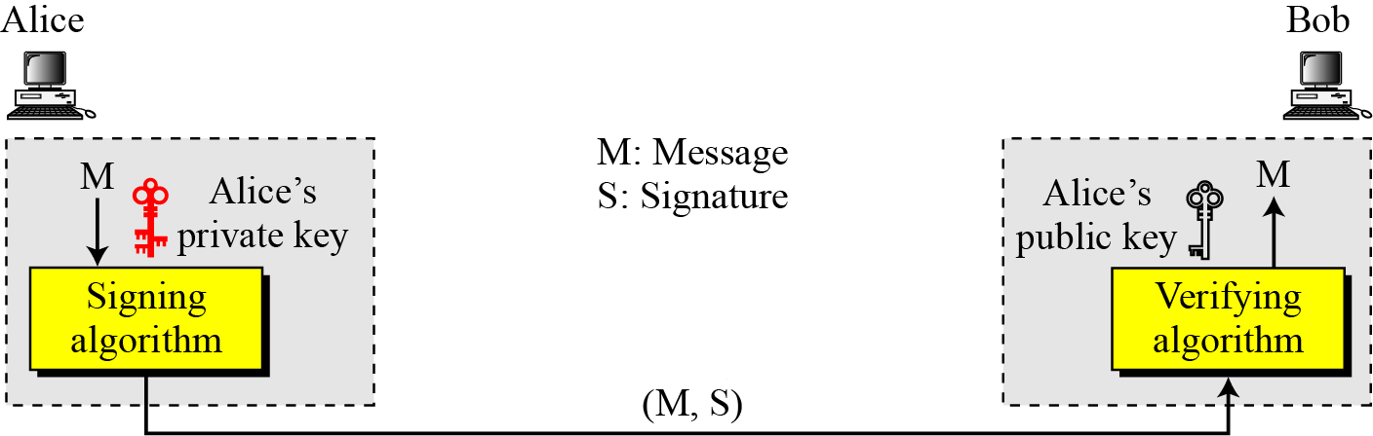

13.2.1 Need for Keys
Figure 13.2 Adding key to the digital signature process
Note
A digital signature needs a public-key system.
The signer signs with her private key; the verifier verifies with the signer’s public key.

Slide 11
13.2.1 Continued
Note
A cryptosystem uses the private and public keys of the receiver: a digital signature uses
the private and public keys of the sender.

Slide 12
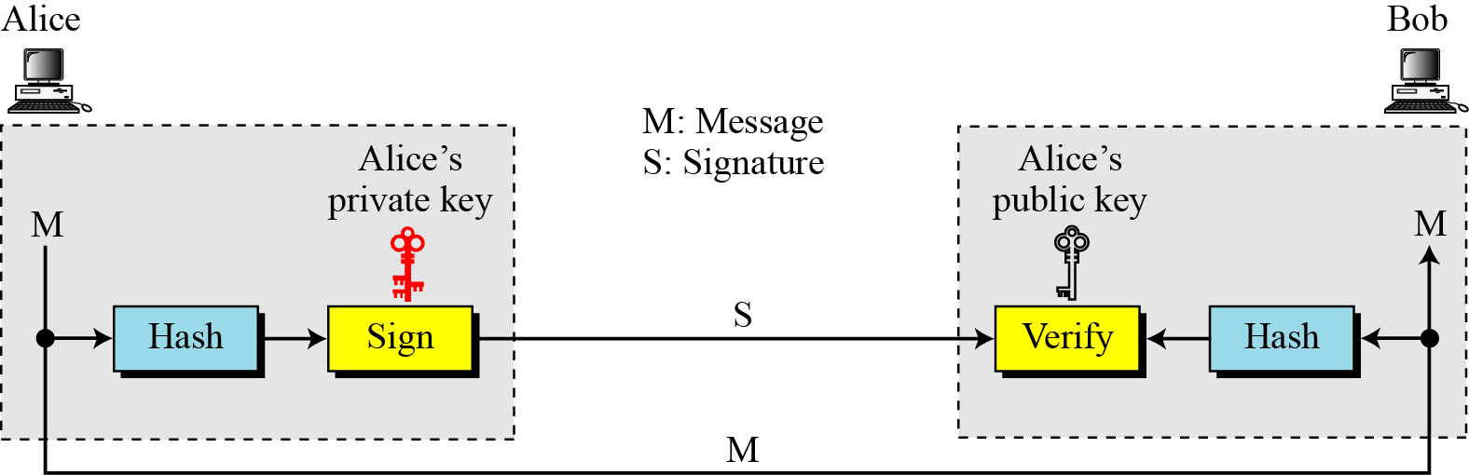
13.2.2 Signing the Digest
Figure 13.3 Signing the digest

Slide 13
13-3 SERVICES
We discussed several security services in Chapter 1 including message confidentiality, message authentication, message integrity, and nonrepudiation. A digital signature can directly provide the last three; for message confidentiality we still need encryption/decryption.
Topics discussed in this section:
13.3.1 Message Authentication
13.3.2 Message Integrity
13.3.3 Nonrepudiation
13.3.4 Confidentiality

Slide 14
13.3.1 Message Authentication
A secure digital signature scheme, like a secure conventional signature can provide message authentication.
Note
A digital signature provides message authentication.

Slide 15
13.3.2 Message Integrity
The integrity of the message is preserved even if we sign the whole message because we cannot get the same signature if the message is changed.
Note
A digital signature provides message integrity.

Slide 16
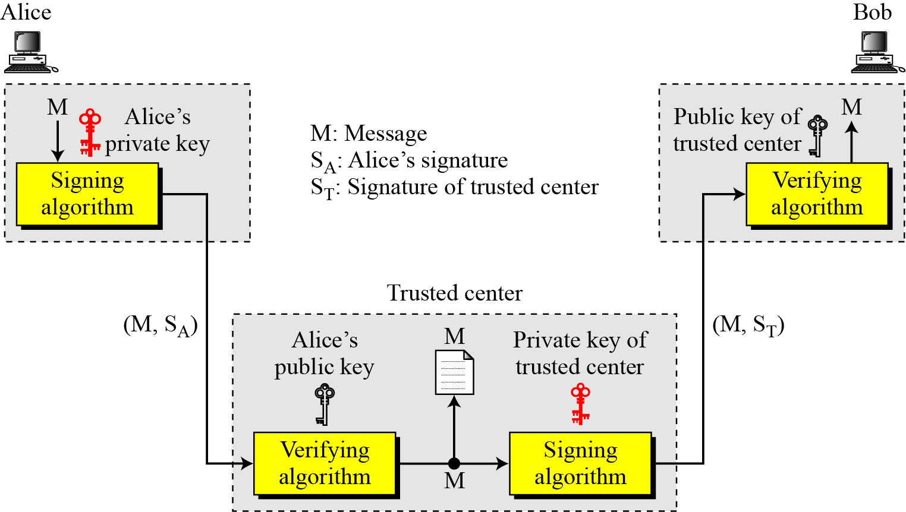
13.3.3 Nonrepudiation
Figure 13.4 Using a trusted center for nonrepudiation
Note
Nonrepudiation can be provided using a trusted party.

Slide 17
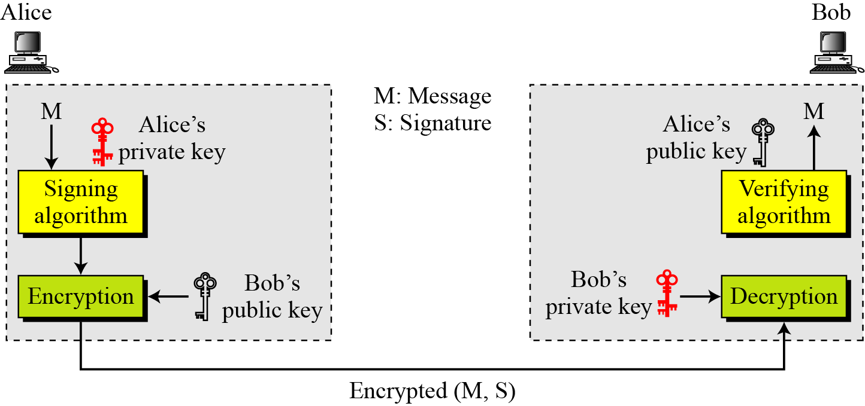
13.3.4 Confidentiality
Figure 13.5 Adding confidentiality to a digital signature scheme
Note
A digital signature does not provide privacy.
If there is a need for privacy, another layer of encryption/decryption must be applied.

Slide 18
13-4 ATTACKS ON DIGITAL SIGNATURE
This section describes some attacks on digital signatures and defines the types of forgery.
Topics discussed in this section:
13.4.1 Attack Types
13.4.2 Forgery Types

Slide 19
13.4.1 Attack Types
Key-Only Attack
Known-Message Attack
Chosen-Message Attack

Slide 20
13.4.2 Forgery Types
Existential Forgery
Selective Forgery

Slide 21
13-5 DIGITAL SIGNATURE SCHEMES
Several digital signature schemes have evolved during the last few decades. Some of them have been implemented.
Topics discussed in this section:
13.5.1 RSA Digital Signature Scheme
13.5.2 ElGamal Digital Signature Scheme
13.5.3 Schnorr Digital Signature Scheme
13.5.4 Digital Signature Standard (DSS)
13.5.5 Elliptic Curve Digital Signature Scheme

Slide 22
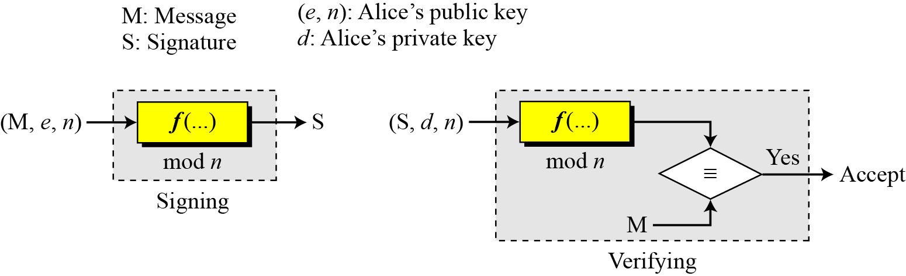
13.5.1 RSA Digital Signature Scheme
Figure 13.6 General idea behind the RSA digital signature scheme

Slide 23
13.5.1 Continued
Key Generation
Key generation in the RSA digital signature scheme is exactly the same as key generation in the RSA
Note
In the RSA digital signature scheme, d is private; e and n are public.

Slide 24
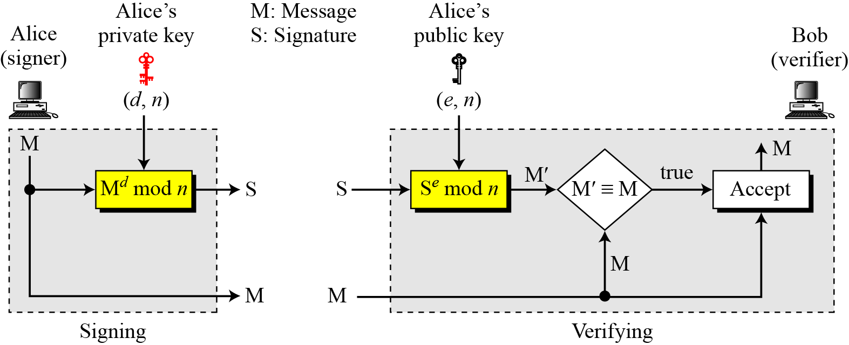
13.5.1 Continued
Signing and Verifying
Figure 13.7 RSA digital signature scheme

Slide 25
13.5.1 Continued
Example 13.1
As a trivial example, suppose that Alice chooses p = 823 and q = 953, and calculates n = 784319. The value of φ(n) is 782544. Now she chooses e = 313 and calculates d = 160009. At this point key generation is complete. Now imagine that Alice wants to send a message with the value of M = 19070 to Bob. She uses her private exponent, 160009, to sign the message:
Alice sends the message and the signature to Bob. Bob receives the message and the signature. He calculates
Bob accepts the message because he has verified Alice’s signature.

Slide 26
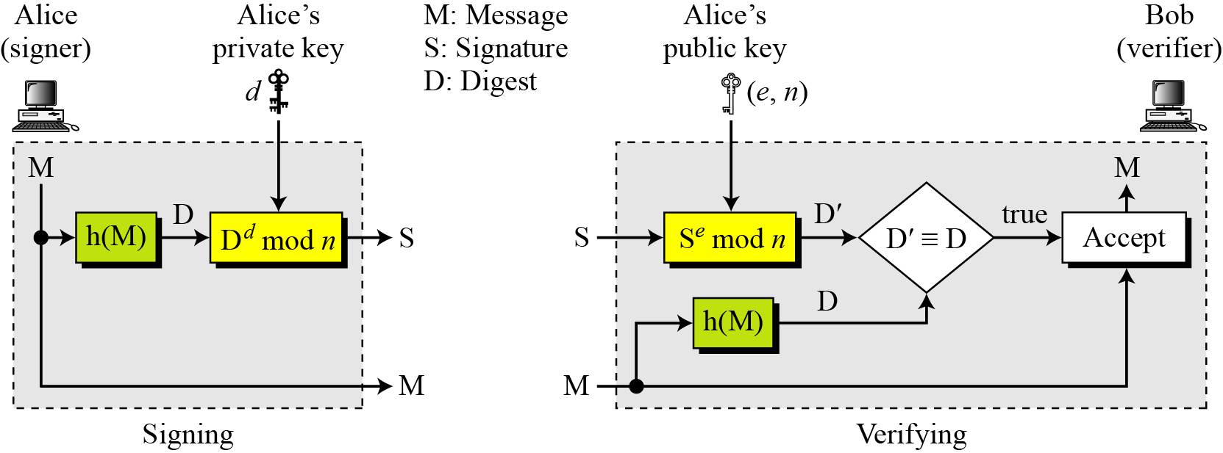
13.5.1 Continued
RSA Signature on the Message Digest
Figure 13.8 The RSA signature on the message digest

Slide 27
13.5.1 Continued
Note
When the digest is signed instead of the message itself, the susceptibility of the RSA digital signature scheme depends on the strength of the hash algorithm.

Slide 28
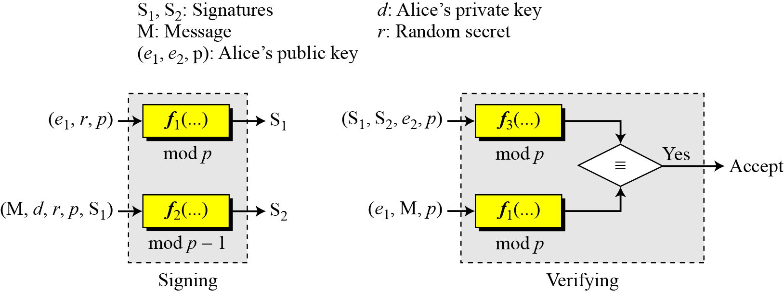
13.5.2 ElGamal Digital Signature Scheme
Figure 13.9 General idea behind the ElGamal digital signature scheme

Slide 29
13.5.2 Continued
Key Generation
The key generation procedure here is exactly the same as the one used in the cryptosystem.
Note
In ElGamal digital signature scheme, (e₁, e₂, p) is Alice’s public key; d is her private key.

Slide 30
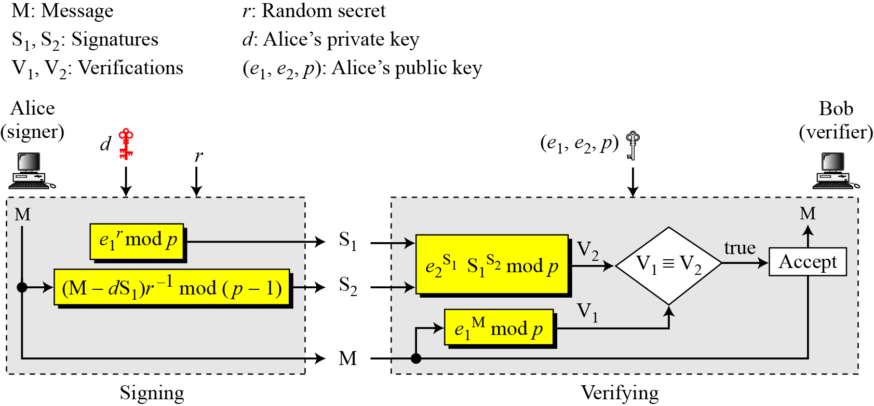
13.5.2 Continued
Verifying and Signing
Figure 13.10 ElGamal digital signature scheme

Slide 31
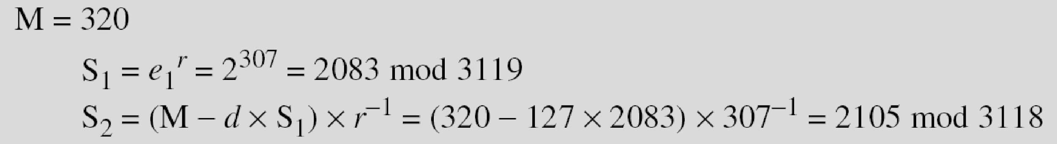
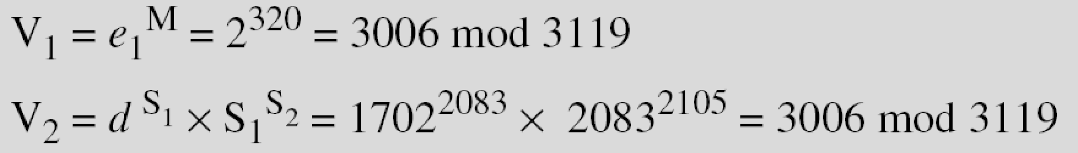
13.5.1 Continued
Example 13.2
Here is a trivial example. Alice chooses p = 3119, e₁ = 2, _{d} = 127 and calculates e₂ = 2¹²⁷ mod 3119 = 1702. She also chooses r to be 307. She announces e1, e2, and p publicly; she keeps d secret. The following shows how Alice can sign a message.
Alice sends M, S₁, and S₂ to Bob. Bob uses the public key to calculate V₁ and V₂.

Slide 32
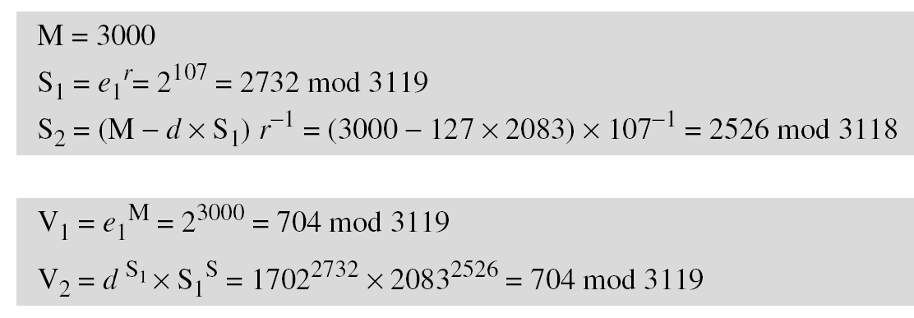
13.5.1 Continued
Example 13.3
Now imagine that Alice wants to send another message, M = 3000, to Ted. She chooses a new r, 107. Alice sends M, S₁, and S₂ to Ted. Ted uses the public keys to calculate V₁ and V₂.

Slide 33
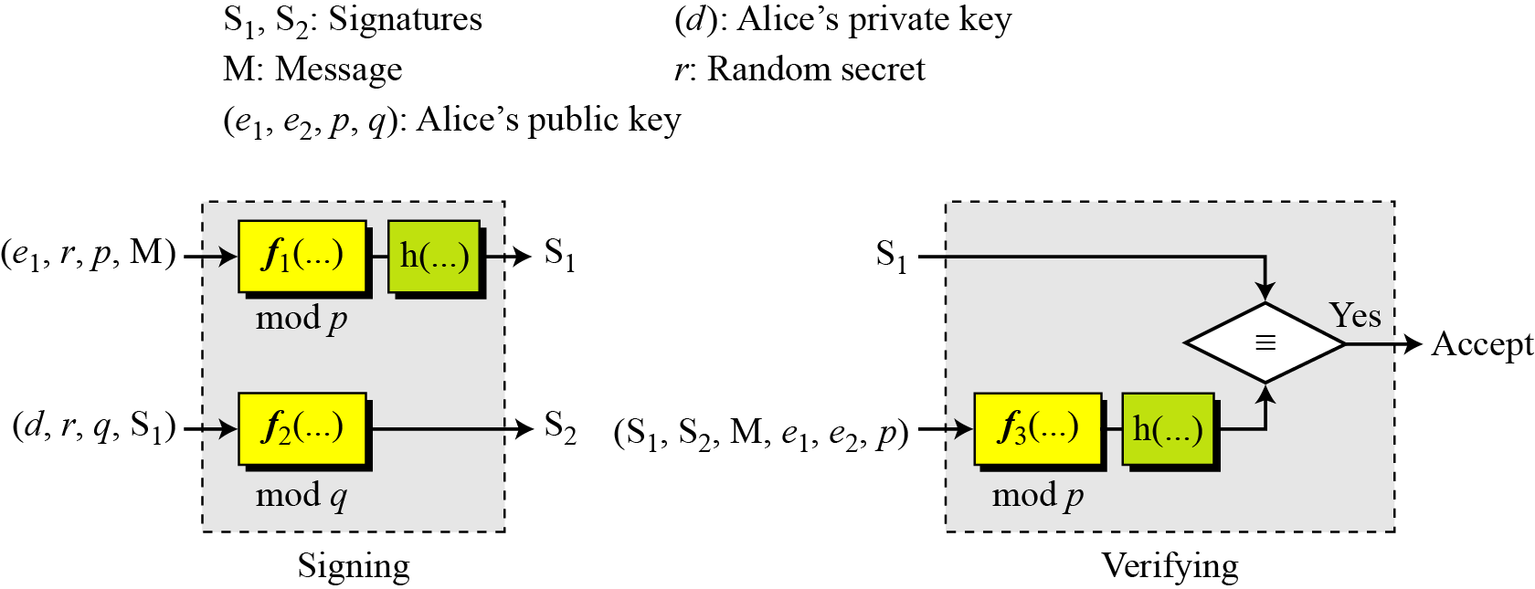
13.5.3 Schnorr Digital Signature Scheme
Figure 13.11 General idea behind the Schnorr digital signature scheme

Slide 34
13.5.3 Continued
Key Generation
Alice selects a prime p, which is usually 1024 bits in length.
Alice selects another prime q.
Alice chooses e₁ to be the qth root of 1 modulo p.
Alice chooses an integer, d, as her private key.
Alice calculates e₂ = e₁^{d} mod p.
Alice’s public key is (e₁, e₂, p, q); her private key is (d).
Note
In the Schnorr digital signature scheme, Alice’s public key is (e₁, e₂, p, q); her private key (d).

Slide 35
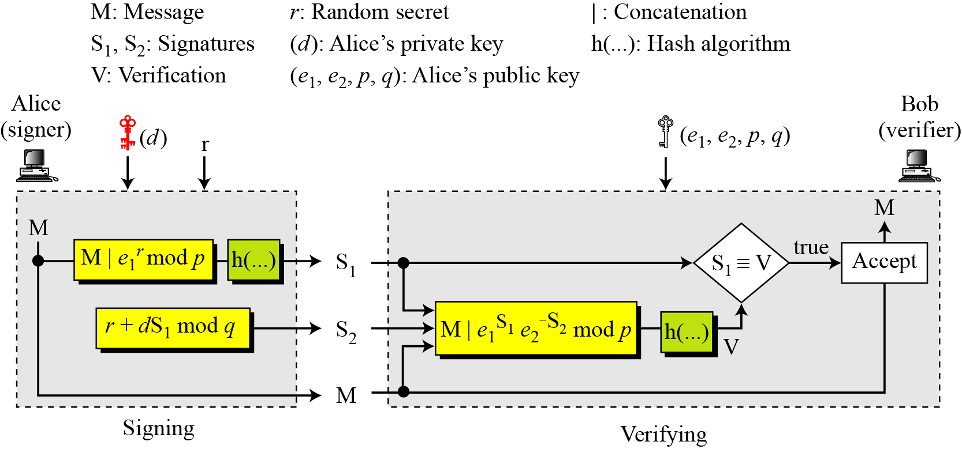
13.5.3 Continued
Signing and Verifying
Figure 13.12 Schnorr digital signature scheme

Slide 36
13.5.3 Continued
Signing
1. Alice chooses a random number r.
2. Alice calculates S₁ = h(M|e₁^{r} mod p).
3. Alice calculates S₂ = r + d × S₁ mod q.
4. Alice sends M, S₁, and S₂.
Verifying Message
1. Bob calculates V = h (M | e₁^{S2} e₂^{−S1} mod p).
2. If S₁ is congruent to V modulo p, the message is accepted;

Slide 37
13.5.1 Continued
Example 13.4
Here is a trivial example. Suppose we choose q = 103 and p = 2267. Note that p = 22 × q + 1. We choose e₀ = 2, which is a primitive in Z₂₂₆₇*. Then (p −1) / q = 22, so we have e₁ = 2²² mod 2267 = 354. We choose d = 30, so e₂ = 354³⁰ mod 2267 = 1206. Alice’s private key is now (d); her public key is (e₁, e₂, p, q).
Alice wants to send a message M. She chooses r = 11 and calculates e₂ ^{r} = 354¹¹ = 630 mod 2267. Assume that the message is 1000 and concatenation means 1000630. Also assume that the hash of this value gives the digest h(1000630) = 200. This means S1 = 200. Alice calculates S2 = r + d × S₁ mod q = 11 + 1026 × 200 mod 103 = 35. Alice sends the message M =1000, S₁ = 200, and S₂ = 35. The verification is left as an exercise.

Slide 38
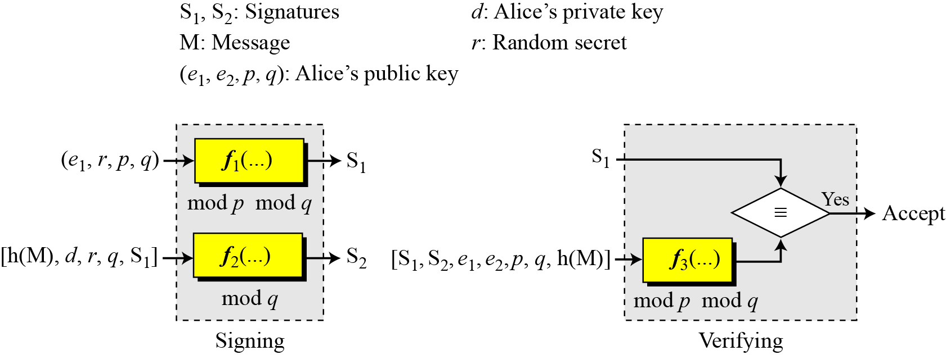
13.5.4 Digital Signature Standard (DSS)
Figure 13.13 General idea behind DSS scheme

Slide 39
13.5.4 Continued
Key Generation.
Alice chooses primes p and q.
Alice uses <Z_{p}*, × > and <Z_{q}*, ×>.
Alice creates e₁ to be the qth root of 1 modulo p.
Alice chooses d and calculates e₂ = e₁^{d}.
Alice’s public key is (e₁, e₂, p, q); her private key is (d).

Slide 40
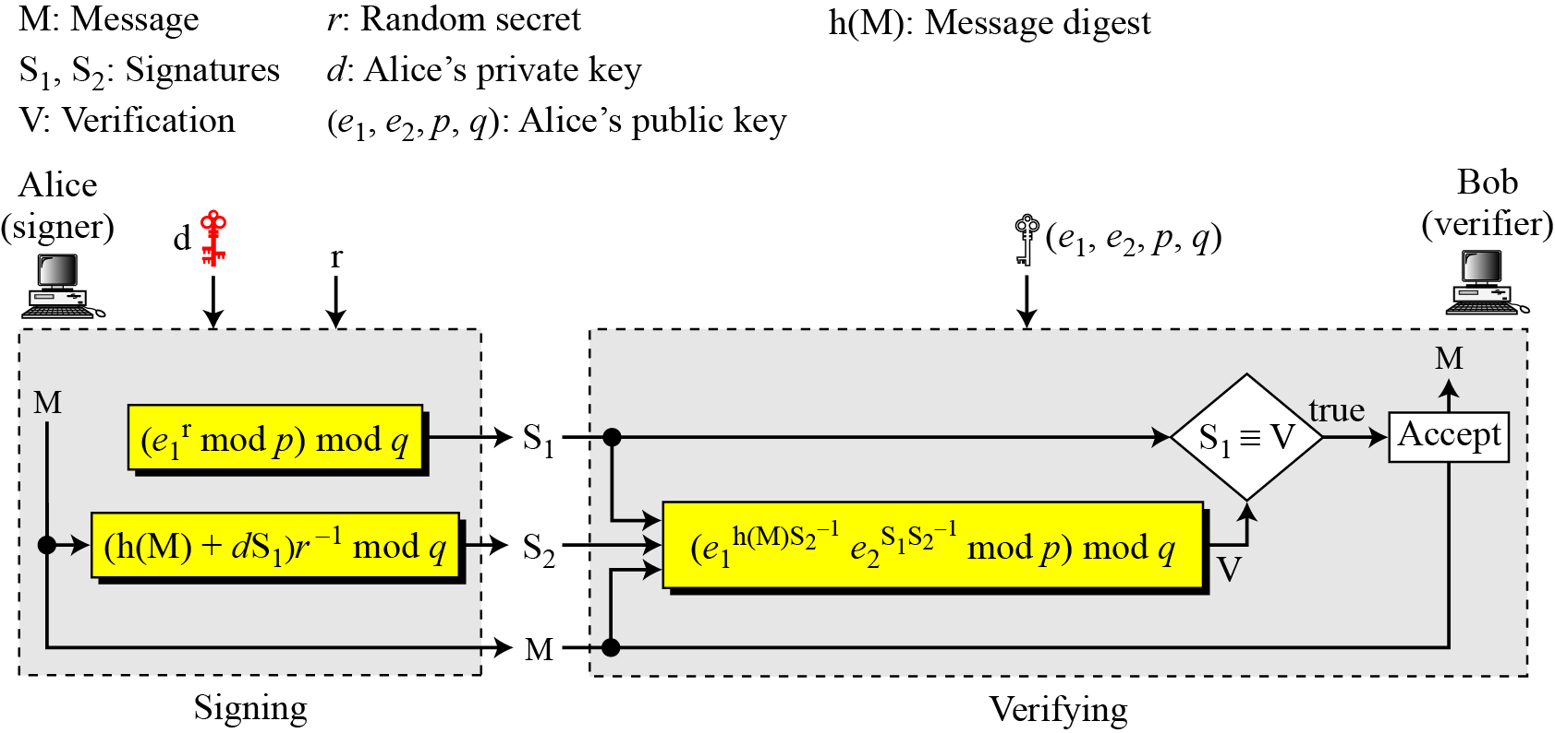
13.5.4 Continued
Verifying and Signing
Figure 13.14 DSS scheme

Slide 41
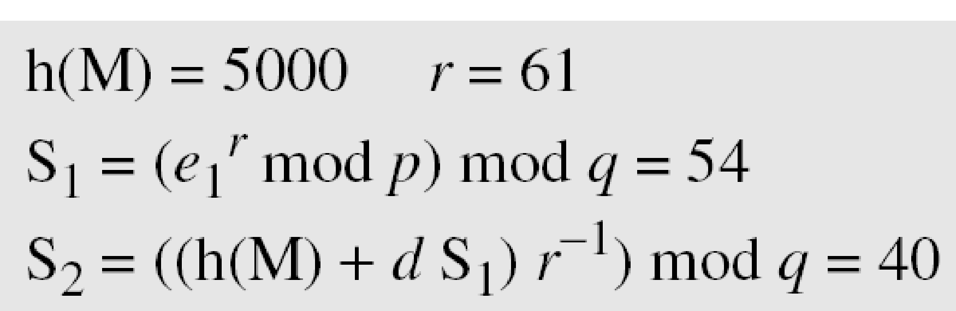
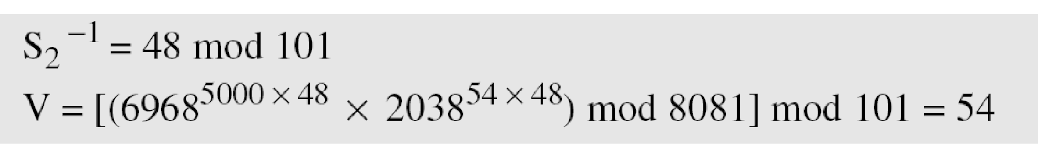
13.5.1 Continued
Example 13.5
Alice chooses q = 101 and p = 8081. Alice selects e₀ = 3 and calculates e¹ = e₀ ^{(p−1)/q} mod p = 6968. Alice chooses d = 61 as the private key and calculates e₂ = e₁^{d} mod p = 2038. Now Alice can send a message to Bob. Assume that h(M) = 5000 and Alice chooses r = 61:
Alice sends M, S₁, and S₂ to Bob. Bob uses the public keys to calculate V.

Slide 42
13.5.4 Continued
DSS Versus RSA
Computation of DSS signatures is faster than computation of RSA signatures when using the same p.
DSS Versus ElGamal
DSS signatures are smaller than ElGamal signatures because q is smaller than p.

Slide 43
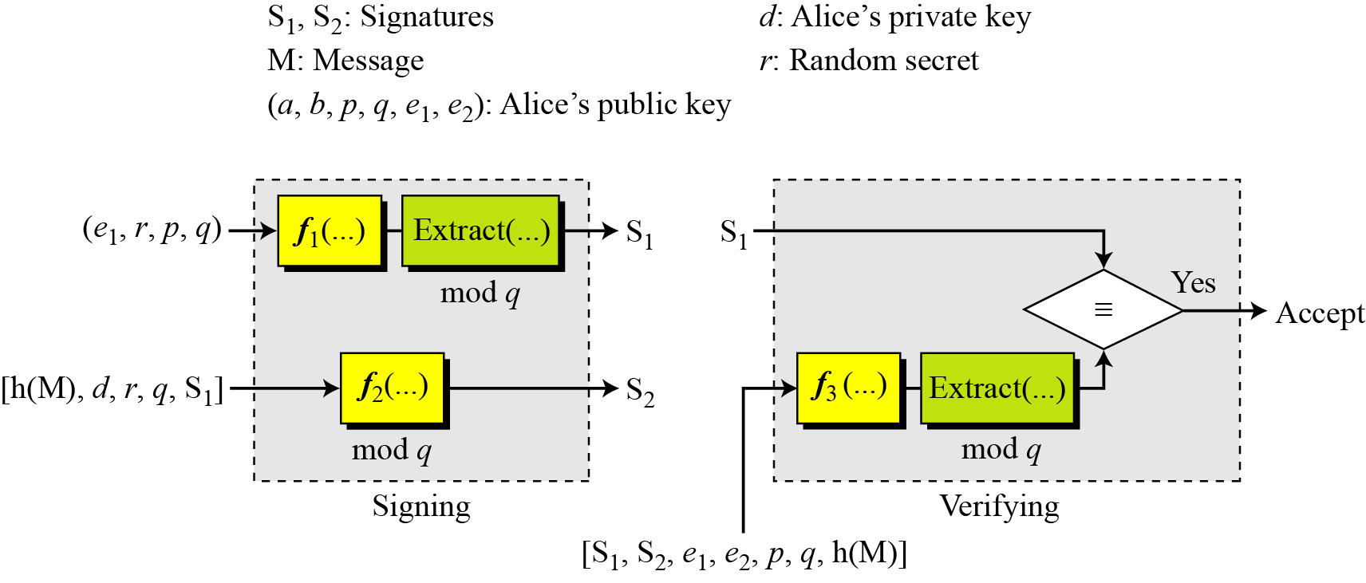
13.5.5 Elliptic Curve Digital Signature Scheme
Figure 13.15 General idea behind the ECDSS scheme

Slide 44
13.5.5 Continued
Key Generation
Key generation follows these steps:
Alice chooses an elliptic curve E_{p}(a, b).
Alice chooses another prime q the private key d.
Alice chooses e₁(…, …), a point on the curve.
Alice calculates e₂(…, …) = d × e₁(…, …).
Alice’s public key is (a, b, p, q, e1, e2); her private key is d.

Slide 45
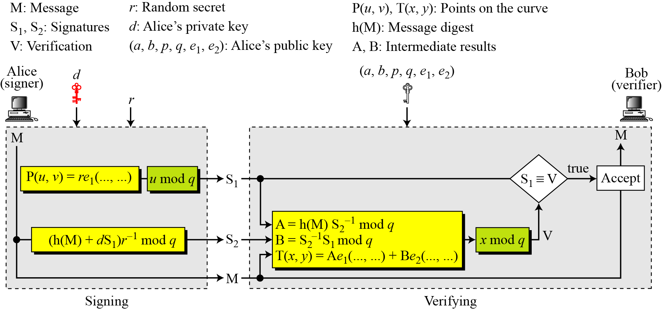
13.5.5 Continued
Signing and Verifying
Figure 13.16 The ECDSS scheme

Slide 46
13-6 VARIATIONS AND APPLICATIONS
This section briefly discusses variations and applications for digital signatures.
Topics discussed in this section:
13.6.1 Variations
13.6.2 Applications

Slide 47
13.6.1 Variations
Time Stamped Signatures
Sometimes a signed document needs to be time stamped to prevent it from being replayed by an adversary. This is called time-stamped digital signature scheme.
Blind Signatures
Sometimes we have a document that we want to get signed without revealing the contents of the document to the signer.

